Slide 1

MARS ROVER
Logo here
Nursabrina Suraya Binti Muhammad Fadli
Date

Slide 2
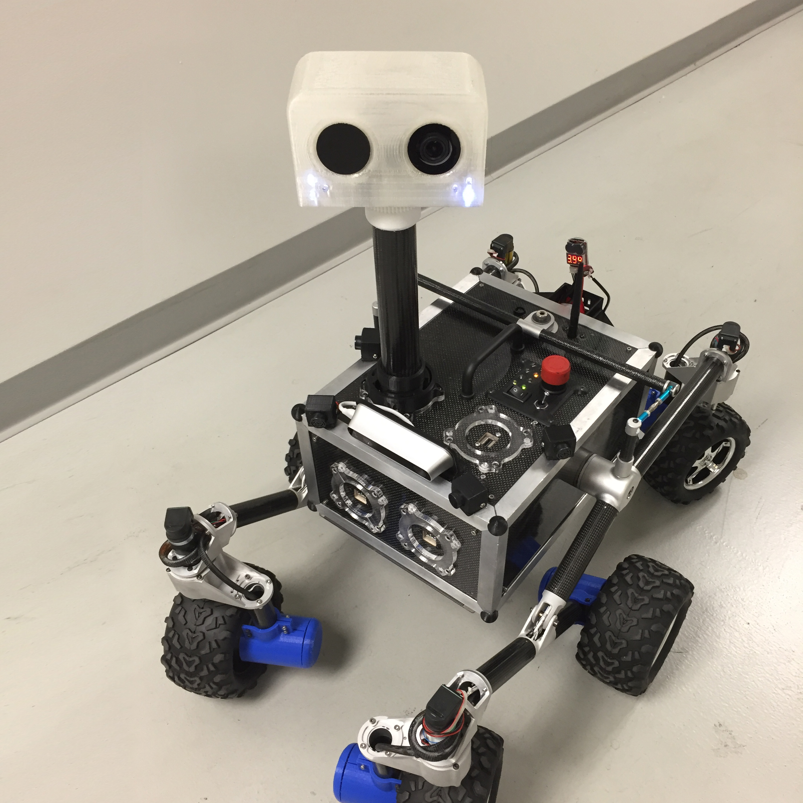

ROV-E
ROV-E is a new Mars outreach rover used to engage the public. The rover was modeled after some of NASA's most famous rovers, Curiosity and the upcoming Mars 2020 rover. The rover can drive, stream video and roll over kids.
Subtitle

Slide 3
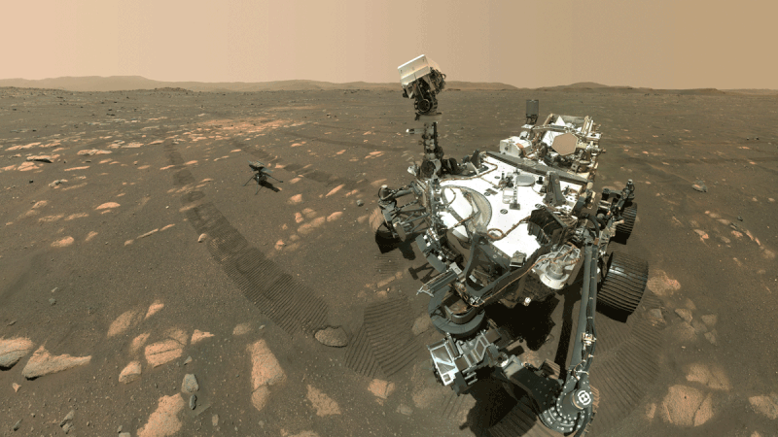
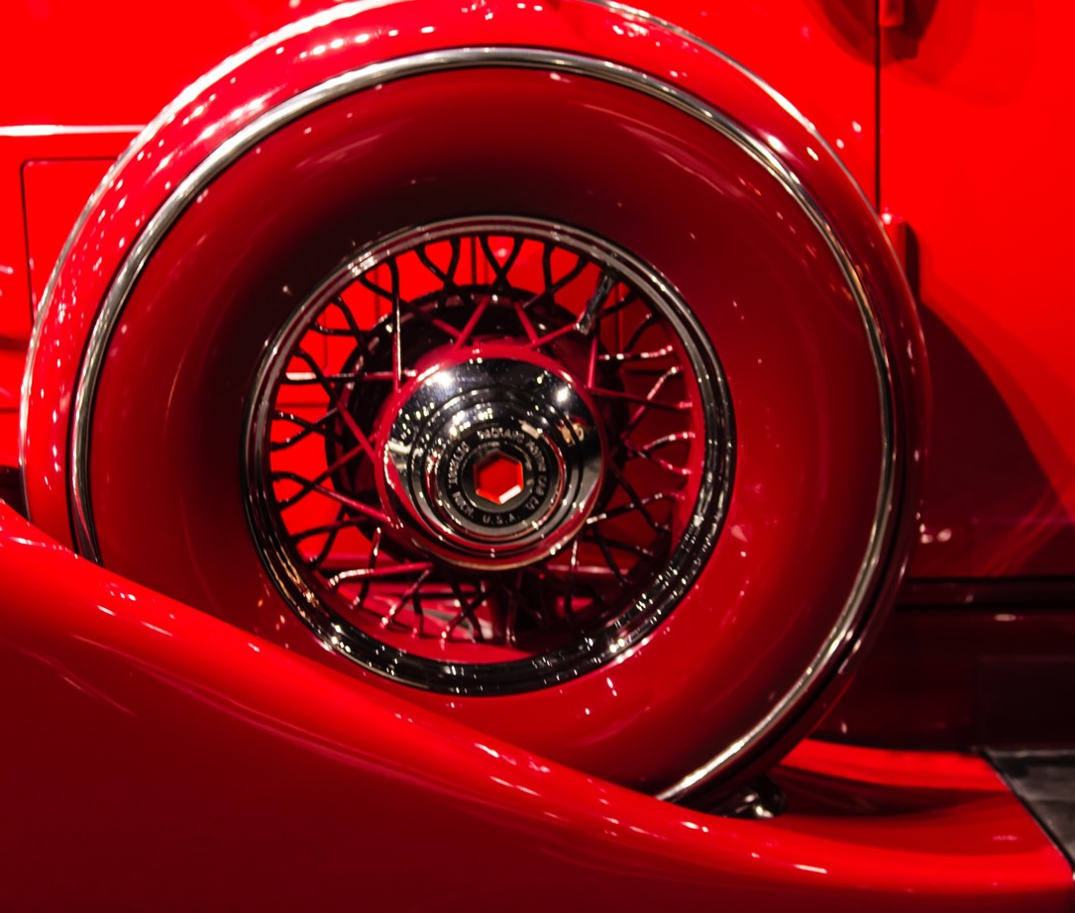
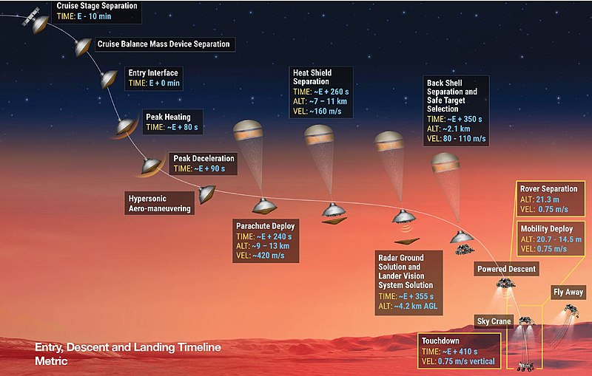
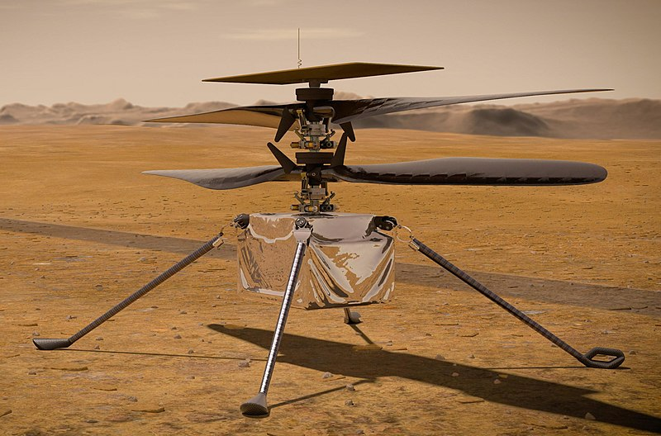
1#PHYSICAL DESIGN FOR VARIOUS APPLICATION
Cruise stage and EDLS( Entry, Descent, and Landing System)
Perseverance rover
Ingenuity helicopter- It will use autonomous control and communicate with Perseverance directly after each landing
Logo here

Slide 4
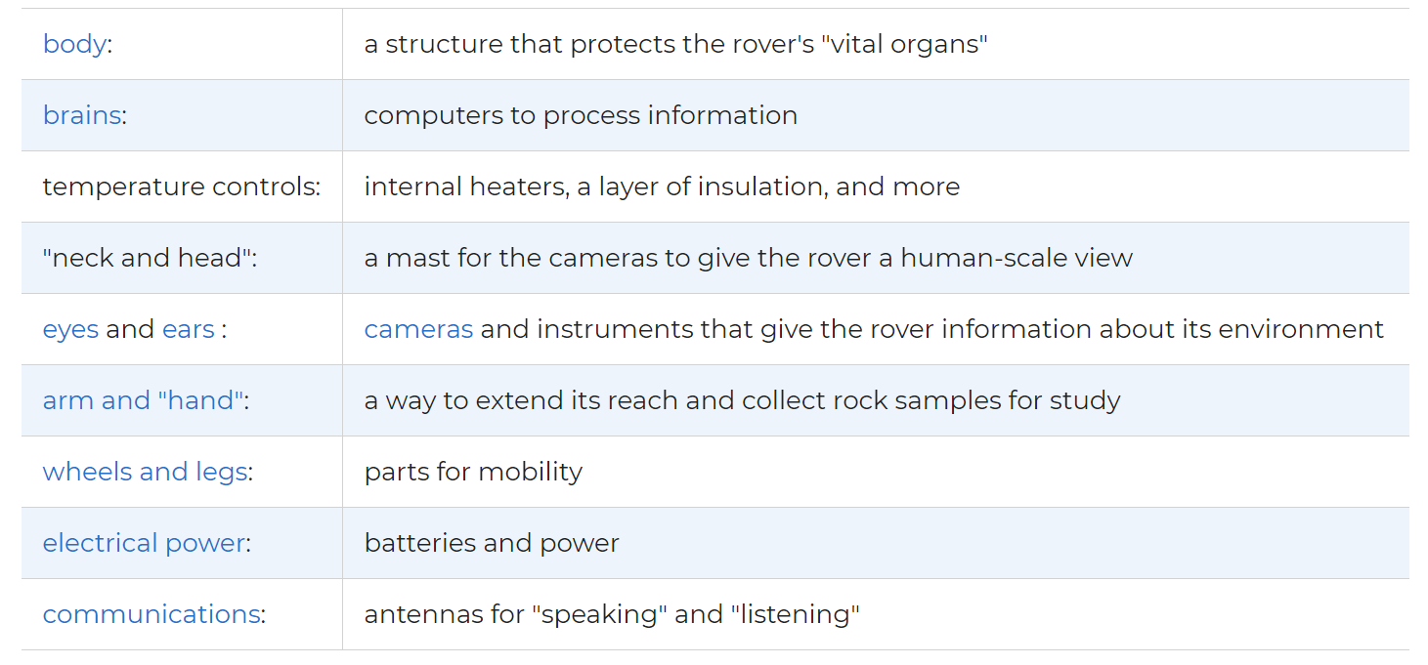
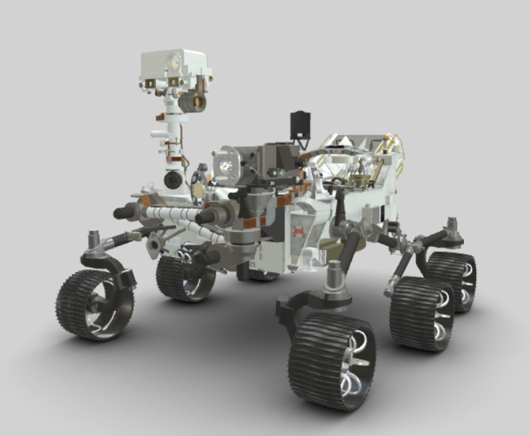
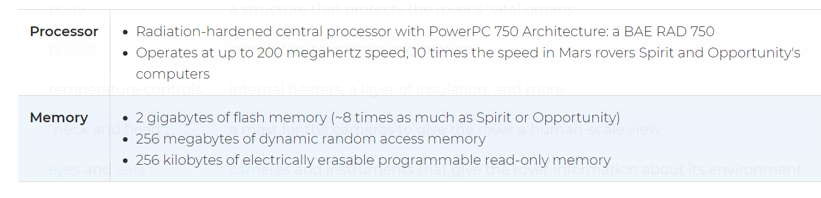
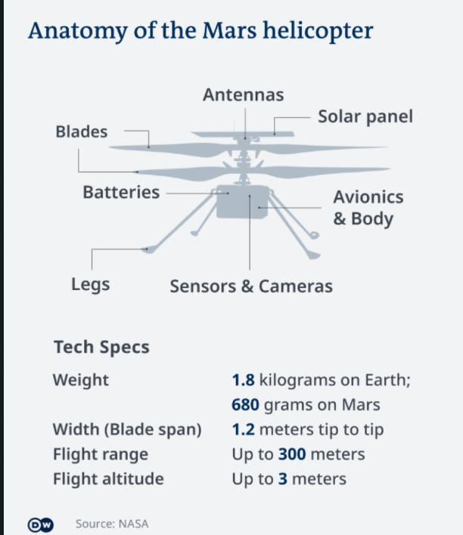
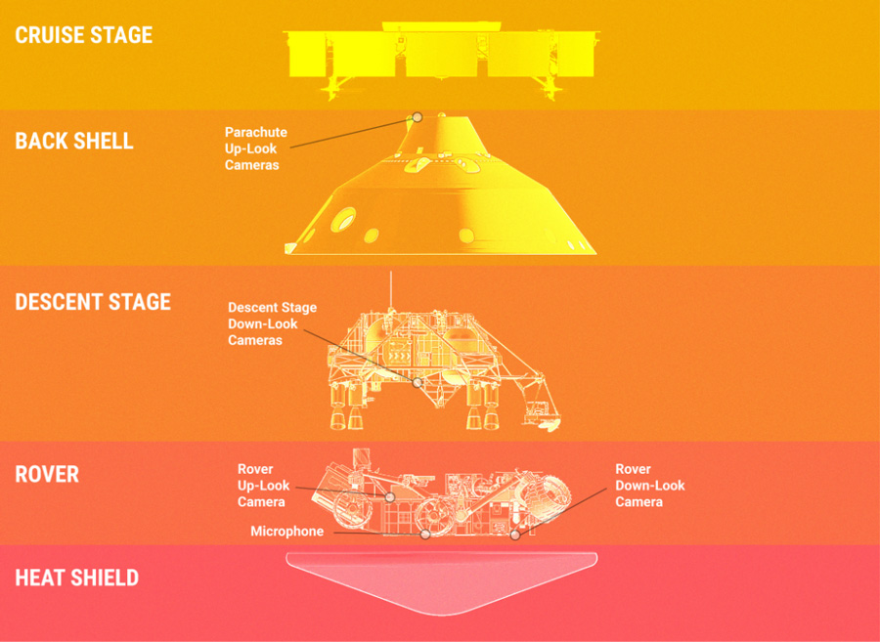
1#PHYSICAL DESIGN FOR VARIOUS APPLICATION
Body-rover body thus keeps the rover's vital organs protected and temperature-controlled.
Brain-balance and position, monitor condition and exchanging information with the team. two "computer brains”
Logo here

Slide 5
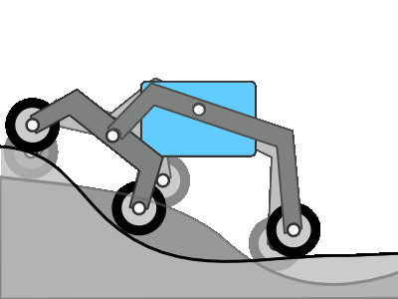

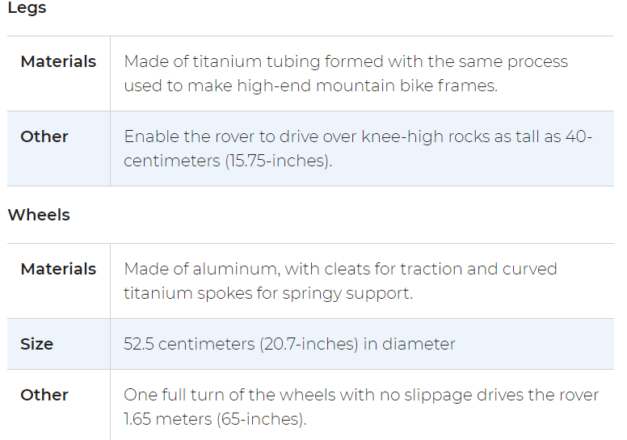
#2 LOCOMOTION SYSTEM AND ACTUATOR
Rocker boogie- he Perseverance rover has six wheels, each with its own individual motor. The two front and two rear wheels also have individual steering motors. This steering capability allows the vehicle to turn in place, a full 360 degrees. The four-wheel steering also allows the rover to swerve and curve, making arcing turns.
Logo here

Slide 6
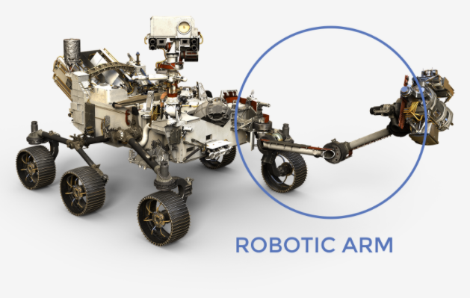
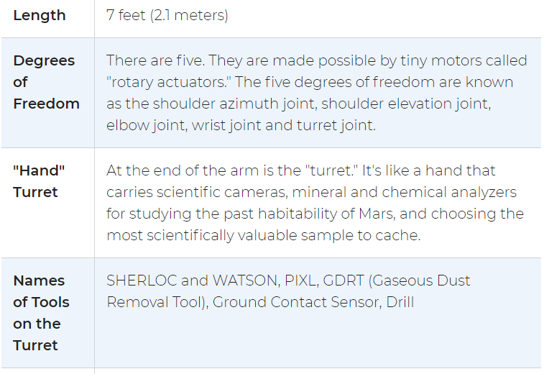
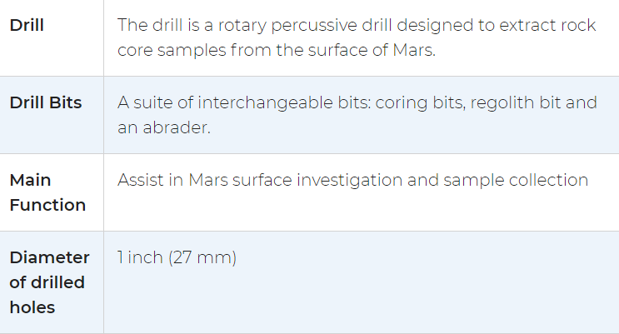
#2 LOCOMOTION SYSTEM AND ACTUATOR
Arm-
Drill- collect rock sample
Ground Contact Sensor- The turret has a special sensor to guard against damage if the arm comes into contact with the surface. The contact sensor signals the rover arm to stop if it inadvertently touches the ground.
Logo here

Slide 7
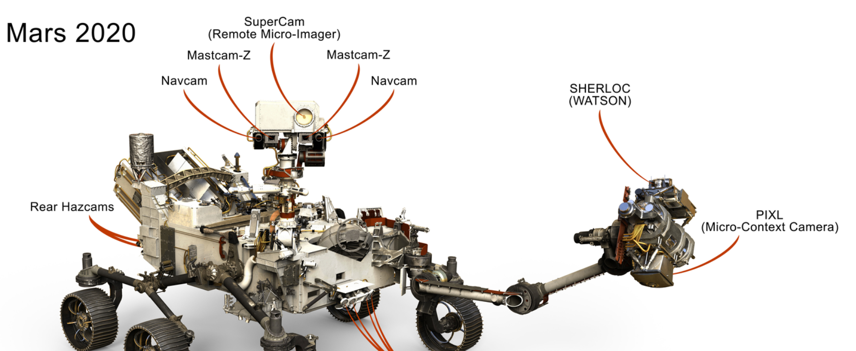
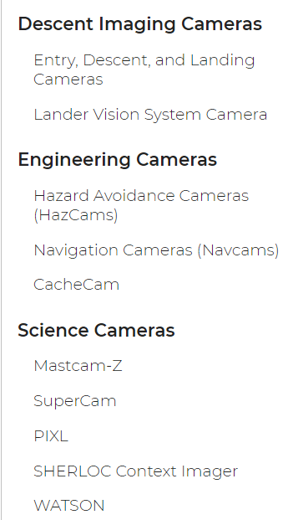
#3 NAVIGATION SYSTEM (SENSOR) AND CONTROL
Camera
Microphone- record sound of Mars, Sound of Laser Firing, sound of rover’s landing and sound of the rover itself.
Logo here

Slide 8
#3 NAVIGATION SYSTEM (SENSOR) AND CONTROL
Mastcam-Z, To take high-definition video, panoramic color and 3D images of the Martian surface and features in the atmosphere with a zoom lens to magnify distant targets
The Mars Environmental Dynamics Analyzer is known as MEDA, eather measurements including wind speed and direction, temperature and humidity, and also measures the amount and size of dust particles in the Martian atmosphere.
The Mars Oxygen In-Situ Resource Utilization Experiment is better known as MOXIE, To produce oxygen from the Martian carbon-dioxide atmosphere
The Planetary Instrument for X-ray Lithochemistry is called PIXL, identifies chemical elements at a tiny scale.
The Radar Imager for Mars' Subsurface Experiment, known as RIMFAX, uses radar waves to probe the ground under the rover.
Scanning Habitable Environments with Raman & Luminescence for Organics & Chemicals has a nickname: SHERLOC- Fine-scale detection of minerals, organic molecules and potential biosignatures
SuperCam examines rocks and soils with a camera, laser and spectrometers to seek organic compounds that could be related to past life on Mars.
Logo here

Slide 9
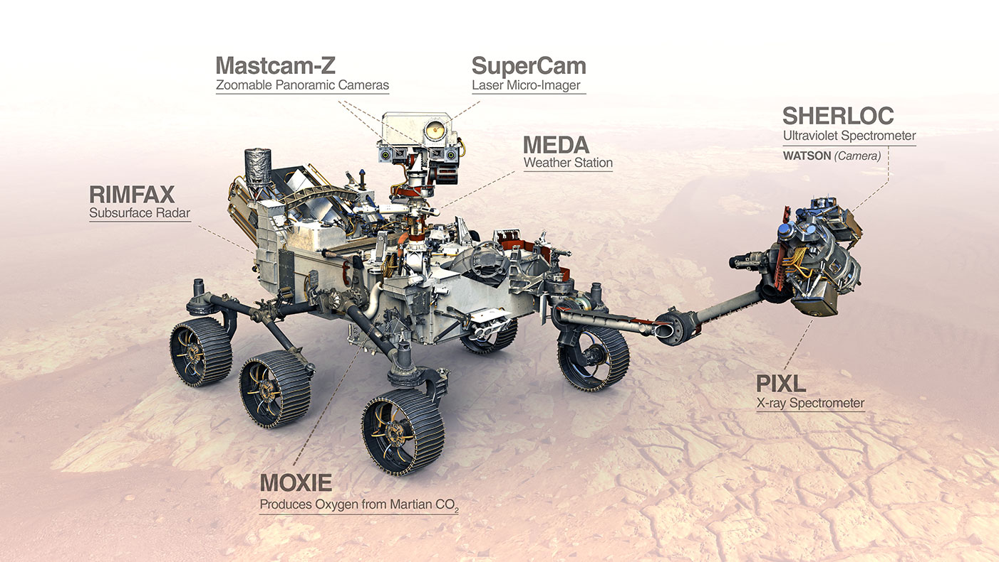
#4 DATA COLLECTION
By using science instrument- to collect data on Martian geology, atmosphere, environmental conditions, and potential biosignatures.
Step 1: Collecting the Samples
Step 2: Sample Sealing and Storing Onboard
Step 3: Depositing the Samples on the Surface
Logo here

Slide 10
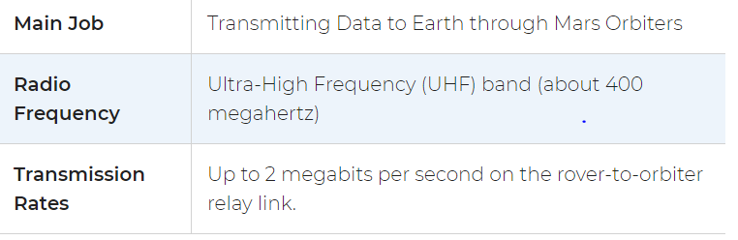
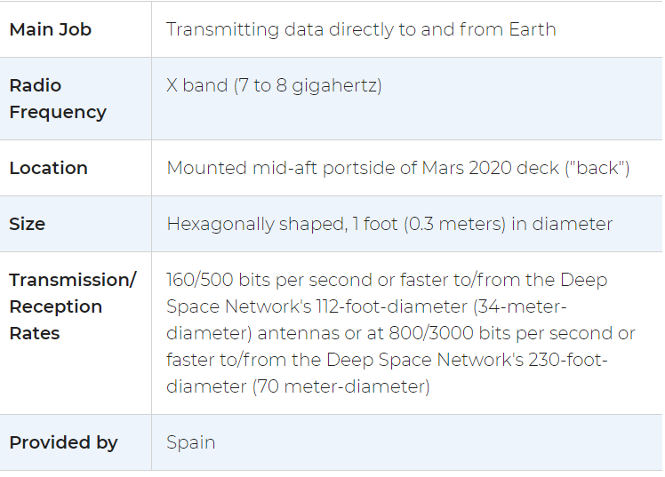
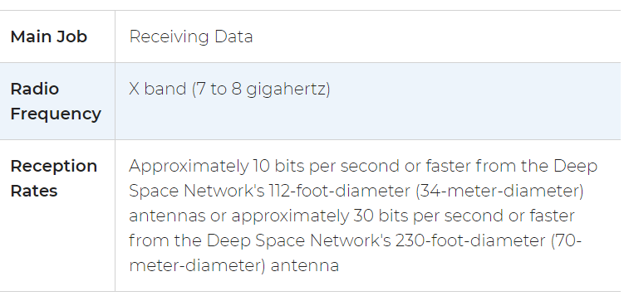
#5 DATA TRANSMISSION
Ultra-High Frequency Antenna
X-band High-Gain Antenna
X-band Low-Gain Antenna
Logo here

Slide 11
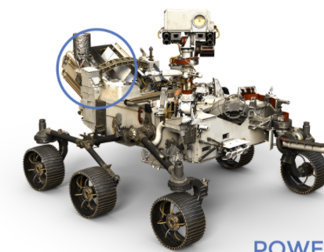
#6 POWER MANAGEMENT
Two lithium-ion rechargeable batteries
Perseverance carries a radioisotope power system. This power system produces a dependable flow of electricity using the heat of plutonium's radioactive decay as its "fuel.“
"Multi-Mission Radioisotope Thermoelectric Generator" or MMRTG for short.
Logo here

